Slide 1
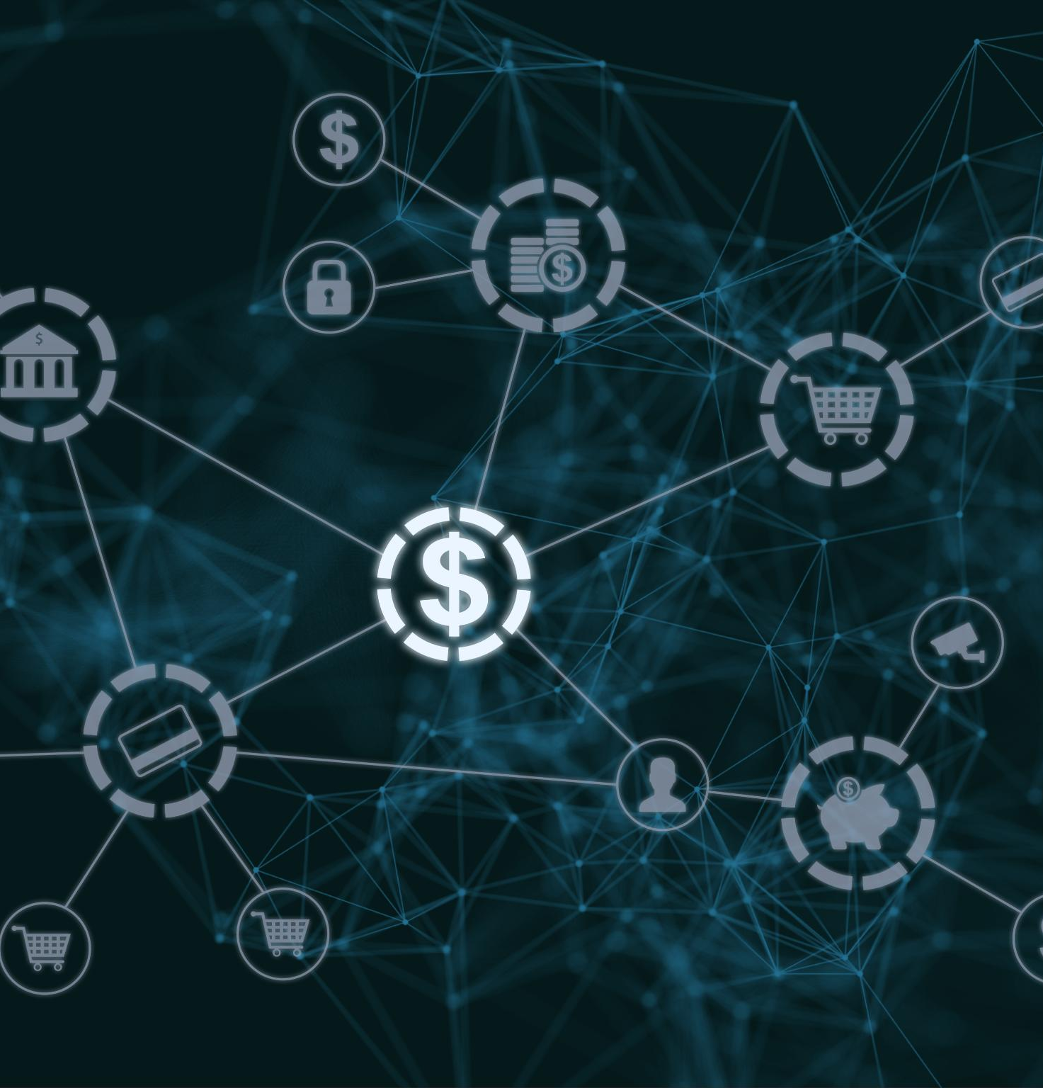
Payment Ecosystem Overview: Comprehensive Guide to Payment Industry Structure and Processes
Understanding transaction flow and industry components
30/07/2025
Daniel Sousa
Notes:
---
Welcome to this comprehensive guide on the payment ecosystem. Today, we will explore the structure and processes that govern payment transactions, providing a clear understanding of how money and information flow in the industry.
Image source: Microsoft 365 content library

Slide 2
Presentation Agenda Overview
Introduction and Agenda
Understanding Money and Information Flow in Payments
Key Industry Players and Their Roles
Comparing Acquirer, Sub-Acquirer, and Gateway
Money Flow with Sub-Acquirer
Chargebacks and Cancellations
Chargebacks, Fraud, and Anti-Fraud Solutions
Notes:
This presentation covers an introduction to the payment ecosystem, details on money and information flow, key industry players and their roles, comparisons of acquirer types, the money flow involving sub-acquirers, chargebacks and cancellations, and an overview of fraud and anti-fraud solutions.

Slide 3
Understanding Money and Information Flow in Payments
Notes:
This section explores the dual flow of money and information that enables payment transactions, essential to grasping the ecosystem's operational dynamics.

Slide 4
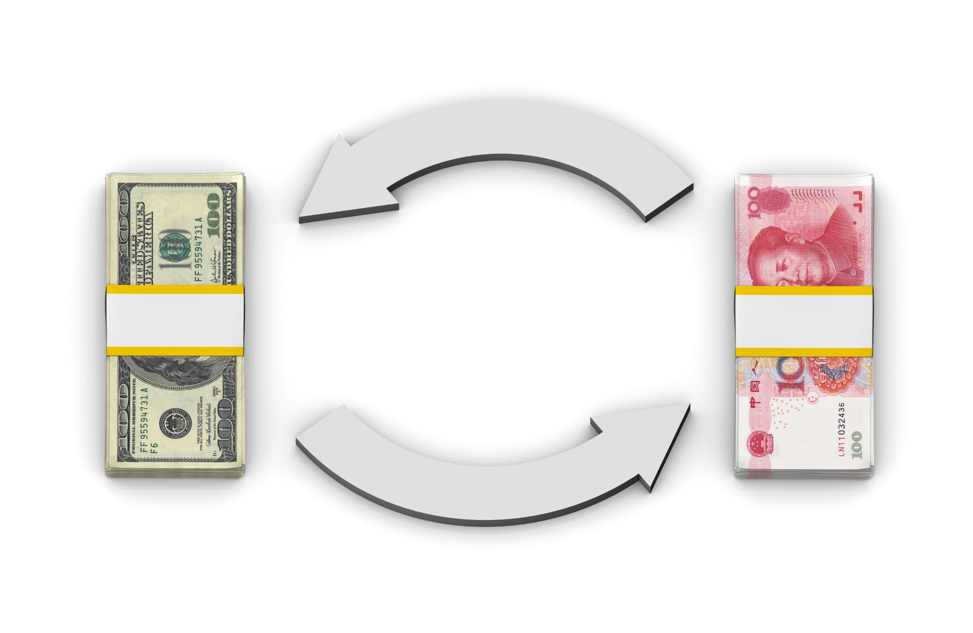
Money Flow Diagram: Customer to Merchant
Customer Payment Initiation
  The money flow starts when the customer initiates a payment using cash, card, or digital wallet at checkout.
Intermediary Processing
  Payment information passes through intermediaries such as payment gateways and banks for authorization and processing.
Merchant Receives Funds
  Once authorized, the money is transferred to the merchant’s account completing the payment flow.
Notes:
---
Visual representation of the path money takes from the customer through various intermediaries until it reaches the merchant, highlighting key transfer points.
Image source: Microsoft 365 content library

Slide 5
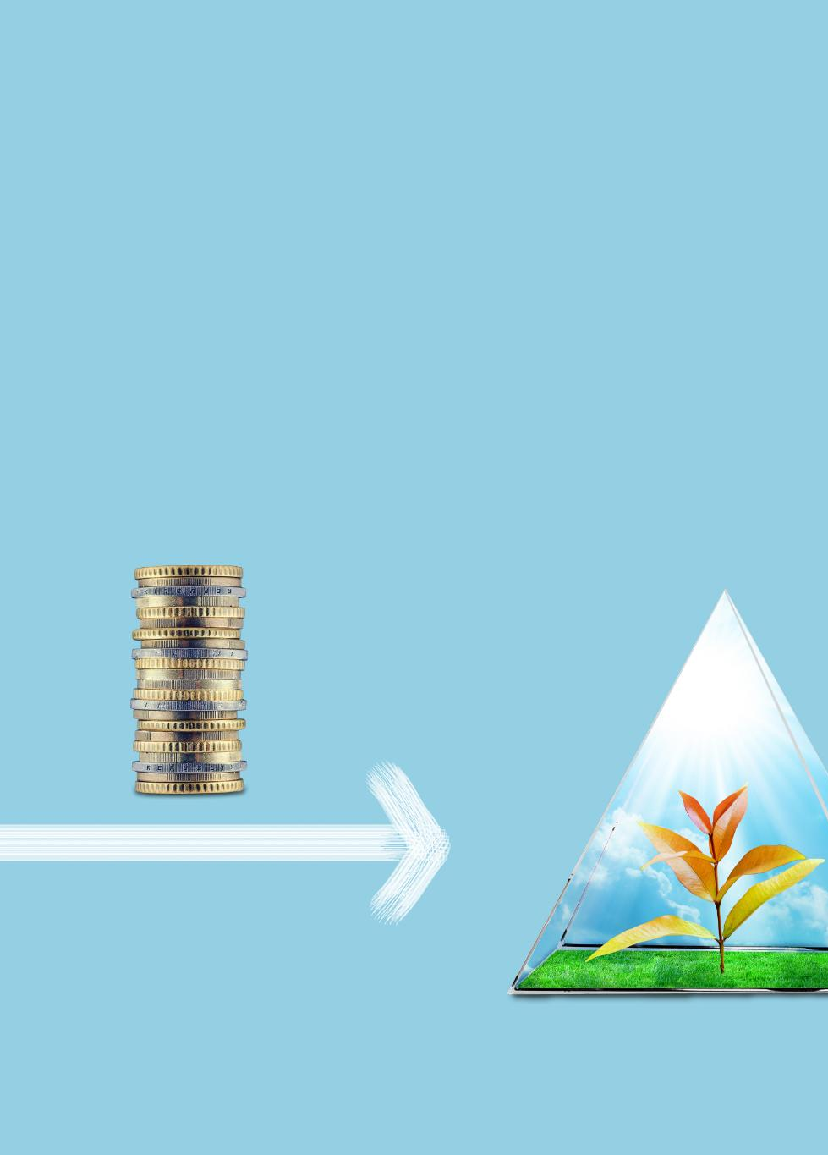
Labeling Gross Amount, Fees, and Net Settlement
Gross Amount Paid
  The total amount paid by the customer before any deductions or fees are applied.
Fees Deducted
  Various fees are deducted by intermediaries such as banks and payment processors.
Net Settlement Received
  The final amount the merchant receives after all fees have been deducted from the gross amount.
Notes:
---
Explanation of financial terms including gross amount paid, fees deducted by intermediaries, and the net settlement that the merchant ultimately receives.
Image source: Microsoft 365 content library

Slide 6
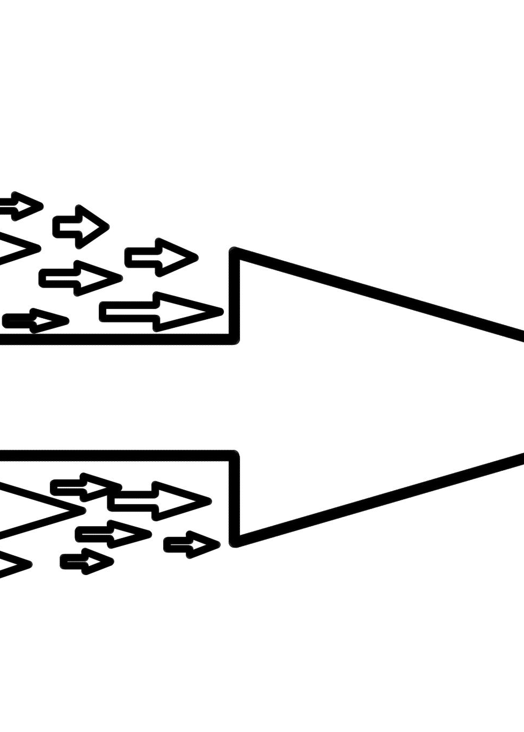
Information Flow Diagram: Authorization, Capture, Settlement
Authorization Stage
  During authorization, payment details are verified and approved by the issuer to ensure funds availability.
Capture Stage
  Capture involves the merchant requesting the transfer of authorized funds to complete the transaction.
Settlement Stage
  Settlement finalizes the transaction by transferring funds between banks and updating accounts accordingly.
Notes:
---
Illustration of how payment information travels during authorization, capture, and settlement stages, underlining the communication between parties involved.
Image source: Microsoft 365 content library

Slide 7
Key Industry Players and Their Roles
Notes:
An overview of the main participants in the payment ecosystem and their respective responsibilities in the transaction process.

Slide 8
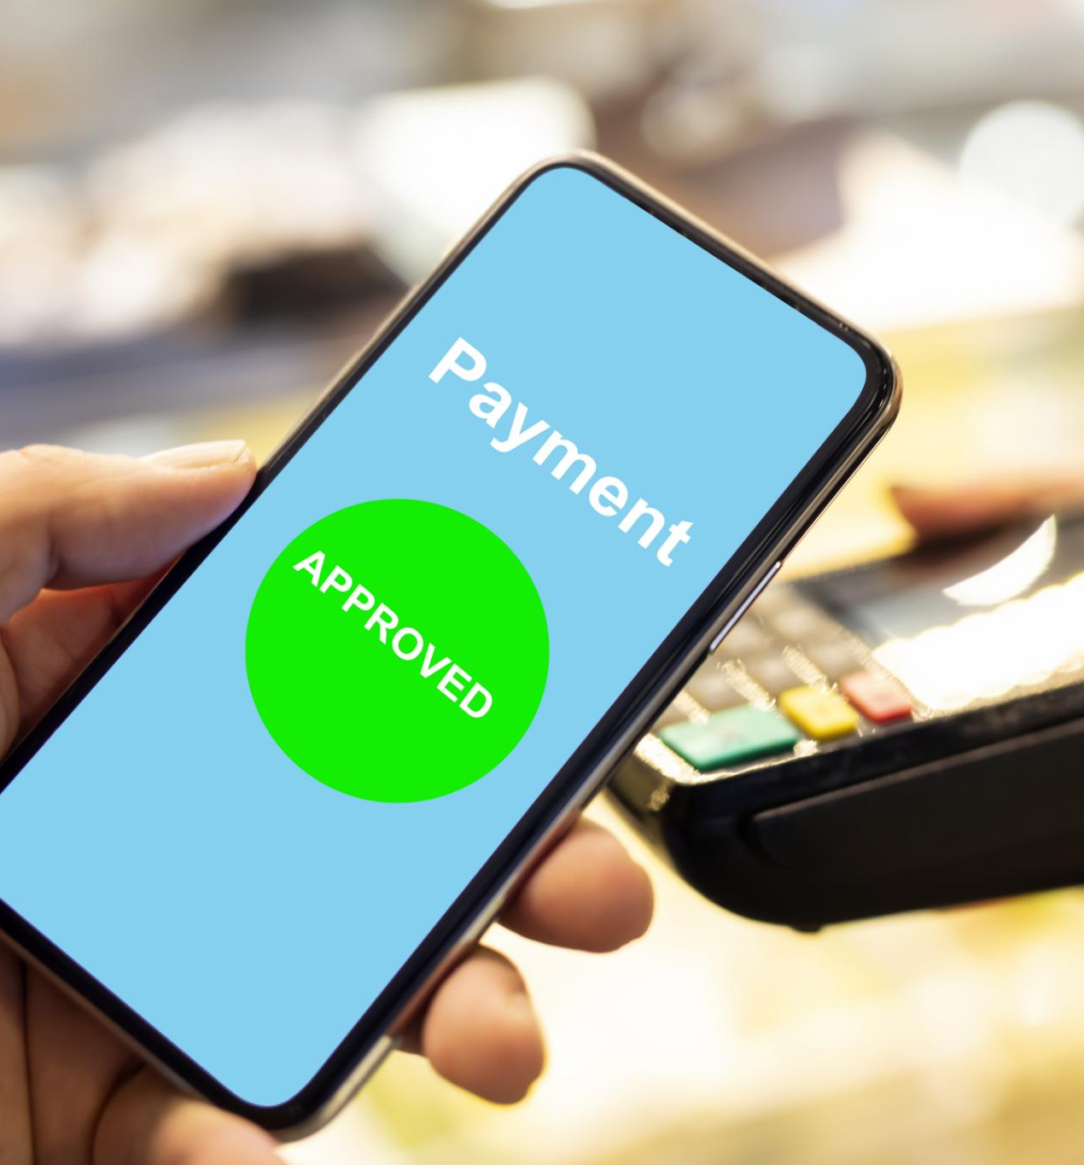
Issuer: Definition and Responsibilities
Issuer Bank Role
  The issuer bank provides payment cards to customers, enabling them to make purchases and payments.
Transaction Authorization
  Issuer banks authorize transactions, playing a critical role in payment approval and fraud prevention.
Notes:
---
Defines the issuer bank, which provides payment cards to customers and authorizes transactions, playing a critical role in payment approvals.
Image source: Microsoft 365 content library

Slide 9
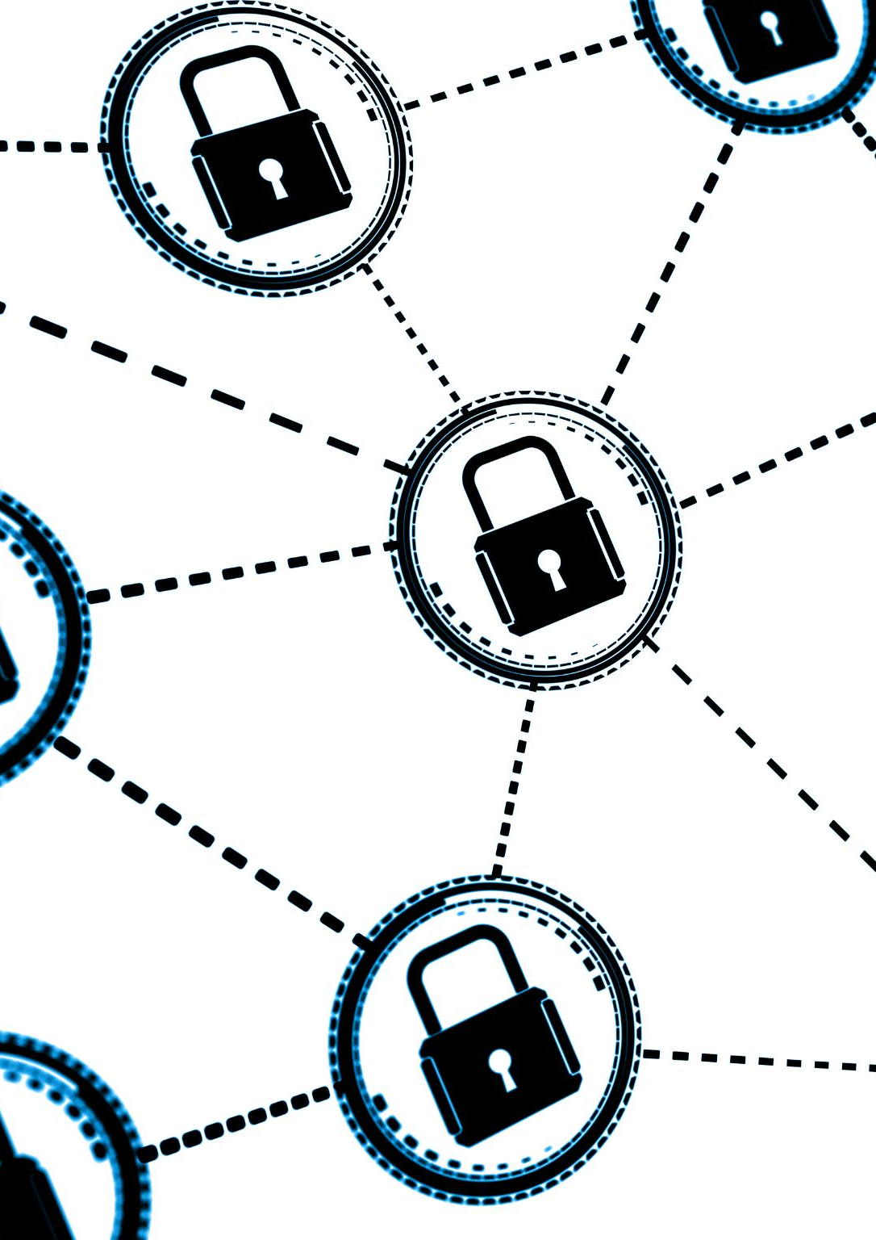
Card Network: Definition and Responsibilities
Intermediary Role
  Card networks act as intermediaries routing transaction data between issuers and acquirers efficiently.
Transaction Security
  They ensure transaction security by implementing robust protocols and encryption standards.
Standards Enforcement
  Card networks maintain and enforce industry standards for smooth and compliant transaction processing.
Notes:
---
Discusses the card network's role as the intermediary that routes transaction data between issuers and acquirers, ensuring transaction security and standards.
Image source: Microsoft 365 content library

Slide 10
Acquirer, Sub-Acquirer, Gateway: Definitions and Roles
Acquirer's Role
  Acquirers process payments on behalf of merchants, facilitating transaction authorization and settlement securely.
Sub-Acquirers' Role
  Sub-acquirers act as intermediaries, connecting smaller merchants to acquirers and managing payment flows.
Gateway's Role
  Gateways provide technical integration enabling merchants to accept payments through digital platforms smoothly.
Notes:
Explains the functions of the acquirer who processes payments for merchants, sub-acquirers who act as intermediaries, and gateways that provide technical integration for payment acceptance.

Slide 11
Comparing Acquirer, Sub-Acquirer, and Gateway
Notes:
This section highlights the differences and similarities among acquirers, sub-acquirers, and gateways, crucial for understanding their contractual and operational distinctions.

Slide 12
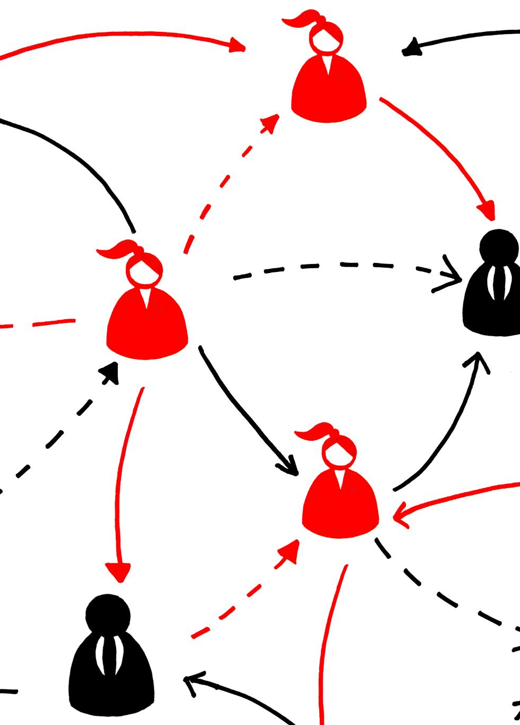
Table: Contract Relationships
Parties Involved
  Different parties engage in contracts forming the foundation of business relationships with merchants.
Contractual Connections
  Contracts define the terms and obligations linking parties and merchants within the ecosystem.
Ecosystem Participants
  Various ecosystem participants collaborate through contracts to ensure smooth operation and mutual benefits.
Notes:
---
A comparative table illustrating the contractual connections each party holds with merchants and other ecosystem participants.
Image source: Microsoft 365 content library

Slide 13

Table: Risk Ownership and Technical Integration
Risk Ownership
  Identifies entities responsible for bearing transaction risk to ensure accountability in payment processes.
Technical Integration Responsibilities
  Outlines each entity's role in integrating and maintaining payment systems for seamless operation.
Notes:
---
Details which entities bear transaction risk and their responsibilities related to technical payment integration.
Image source: Microsoft 365 content library

Slide 14
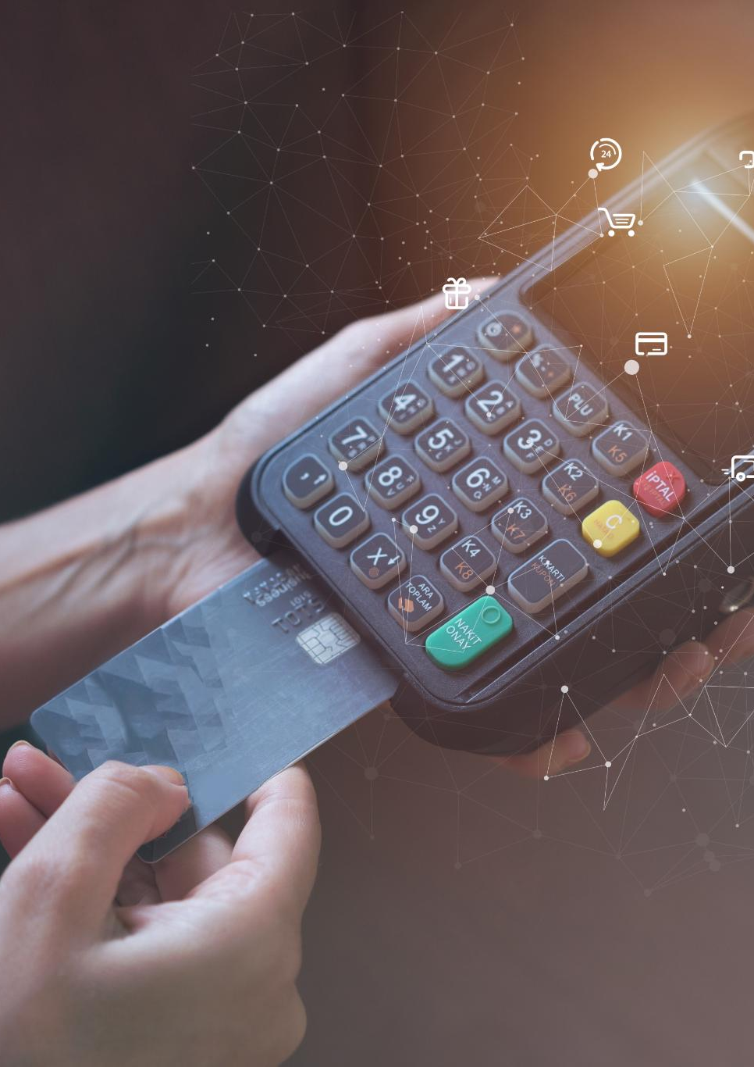
Table: Fee Structure
Acquirers’ Role in Fees
  Acquirers receive fees for processing transactions and managing merchant accounts.
Sub-Acquirers’ Fee Allocation
  Sub-acquirers share fees as intermediaries supporting acquirers in transaction handling.
Gateways’ Fee Contribution
  Gateways earn fees for securely transmitting transaction data between merchants and acquirers.
Notes:
---
Breakdown of how fees are structured and allocated among acquirers, sub-acquirers, and gateways.
Image source: Microsoft 365 content library

Slide 15
Chargebacks and Cancellations
Notes:
Examines the processes and implications of chargebacks and cancellations within payment transactions, including causes and lifecycle management.

Slide 16
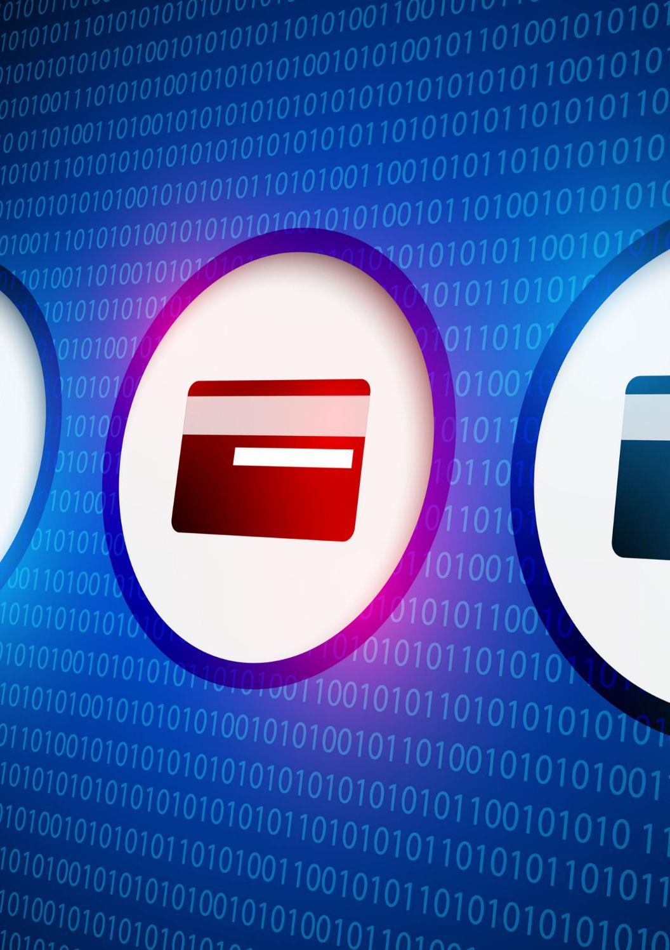
What Is a Chargeback? Lifecycle and Reasons
Definition of Chargeback
  A chargeback is a reversal of a credit card transaction initiated by the cardholder or issuer due to disputes or fraud.
Chargeback Lifecycle
  Chargebacks follow a lifecycle starting from transaction, dispute initiation, investigation, and resolution either in favor of merchant or cardholder.
Common Chargeback Reasons
  Typical reasons include fraudulent transactions, goods not received, incorrect amounts charged, or customer disputes over services.
Notes:
---
Defines chargebacks, outlines their lifecycle, and explains common reasons such as fraud or disputes that trigger chargeback requests.
Image source: Microsoft 365 content library

Slide 17

Chargeback Vs. Cancellation: Flowcharts and Key Differences
Chargeback Process
  Chargebacks involve disputing a transaction through the bank, requiring formal investigation and resolution steps.
Cancellation Process
  Cancellations are typically customer-initiated and handled directly by the merchant with simpler procedural steps.
Customer Impact Differences
  Chargebacks can affect credit and merchant relationships, while cancellations are usually straightforward and less impactful.
Notes:
---
Compares chargebacks and cancellations through flowcharts, highlighting procedural differences and customer impacts.
Image source: Microsoft 365 content library

Slide 18
Chargebacks, Fraud, and Anti-Fraud Solutions
Notes:
Discusses fraud types affecting payments, the impact on the industry, and the solutions designed to mitigate risks and enhance payment security.

Slide 19
Common Fraud Types and Industry Impact
Card-Not-Present Fraud
Card-not-present fraud involves unauthorized use of payment details in online or phone transactions, causing losses.
Identity Theft
Identity theft involves stealing personal information to commit fraud, severely affecting consumers and financial institutions.
Merchant and Bank Consequences
Fraud leads to financial losses, reputational damage, and increased security costs for merchants and banks.
Notes:
---
Reviews typical fraud schemes such as card-not-present fraud and identity theft, emphasizing their consequences for merchants and banks.
Image source: Microsoft 365 content library

Slide 20
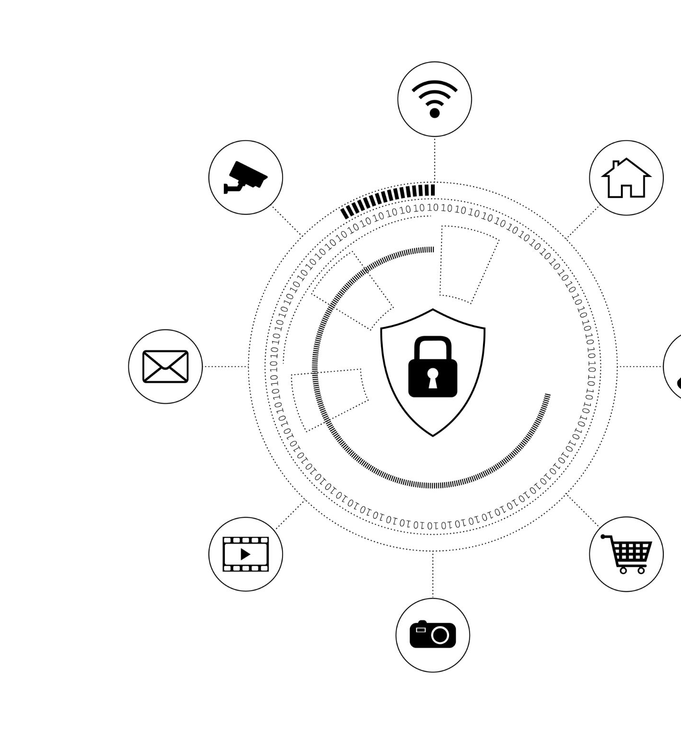
Role of Anti-Fraud Solutions in Prevention
Fraud Detection Technologies
  Advanced technologies identify suspicious activities to detect fraudulent transactions early and accurately.
Prevention Strategies
  Effective strategies prevent fraud by monitoring transactions and implementing strict security protocols.
Stakeholder Protection
  Anti-fraud solutions safeguard all stakeholders by reducing financial losses and maintaining trust.
Notes:
---
Explains how anti-fraud technologies and strategies detect and prevent fraudulent transactions to protect all stakeholders.
Image source: Microsoft 365 content library

Slide 21
Best Practices and Next Steps for Payment Security
Multi-layered Security Measures
Implement multiple security layers to protect payment data from unauthorized access and fraud.
Continuous Monitoring
Monitor payment systems continuously to detect and respond to threats in real time.
Future Payment Safety Improvements
Guide ongoing enhancements in payment security to adapt to evolving threats.
Notes:
---
Recommends industry best practices including multi-layered security measures and continuous monitoring, guiding future improvements in payment safety.
Image source: Microsoft 365 content library

Slide 22
Conclusion
Complex Payment Ecosystem
The payment ecosystem includes numerous players and processes that work together to facilitate transactions.
Importance of Understanding
Grasping the payment structure enables businesses to manage transactions efficiently and securely.
Notes:
The payment ecosystem is complex yet vital, involving multiple players and processes. Understanding its structure helps businesses navigate payments securely and efficiently.

